Slide 1
UNIT IV PART III by Dr. K. Shahu Chatrapati Professor & Addl. Controller of Examinations

Slide 2
Introduction
Clusters are increasingly used for HighPerformance Computing (HPC) due to:
High cost of MPPs vs. availability of networked PCs and workstations.
Balancing HPC workload with generalpurpose workload.
Issues to address:
Resource acquisition and allocation.
Prioritization of workstation owners' tasks.
Support for various parallel program styles.
Admission control and scheduling policies.

Slide 3
3.2 Rigid Jobs with Process Migration 3.2.1 Process Migration
Dynamic environments like Network of Workstations (NOW) require process migration.
Reasons for Process Migration:
Releasing a workstation back to its owner.
Balancing workload across all nodes.

Slide 4
3.2.1 Process Migration
Metrics for Quality of Migration:
Overhead costs of migration.
Degree of detachment from previous location.
Algorithmic Considerations:
Workloadbased migration decisions.
Load measurement and data dissemination.

Slide 5
3.2.2 Case Study: PVM with Migration Parallel Virtual Machine (PVM)
Software package for parallel processing on LANs.
Features:
Communication and synchronization support.
Dynamic process spawning.
Challenges:
Early versions used roundrobin scheduling, leading to workload imbalance.
Solution: Migratable PVM and Dynamic PVM enabled process relocation.
Integrated with MOSIX and Condor for better resource allocation.

Slide 6
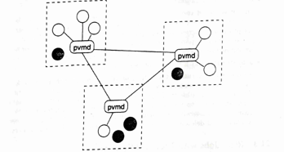
PVM Architecture

Slide 7
3.2.3 Case Study: MOSIX MOSIX Multicomputer OS for UNIX
Load balancing and process migration for parallel jobs.
Key Features:
Symmetric and distributed (no central control).
Does not track workstation ownership.
Maintains workload balance dynamically.
Load Distribution:
Uses randomized loadsharing algorithm.
Periodic updates between workstations trigger migrations if needed.

Slide 8
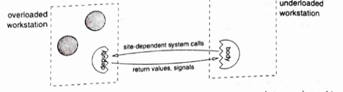

Slide 9
3.3 Malleable Jobs with Dynamic Parallelism Identifying Idle Workstations
3.3.1
HPC jobs use workstation idle cycles.
Best Practices:
Use only fully idle workstations.
Avoid disrupting workstation owners' tasks.
Idle Statistics:
6090% of workstations may be idle at peak hours.
100% idle on nights and weekends.
Requires monitoring of keyboard and mouse activity.

Slide 10
3.3.2 Case Study: Condor and WoDi Condor Batch Job Management
Uses idle workstations for batch processing.
Features:
Suspends and resumes jobs based on workstation availability.
Checkpointing to recover jobs from last state.
Integrated with CARMI for resource request handling.
WoDi (Work Distributor) ensures tasks execute exactly once, even if failures occur.

Slide 11
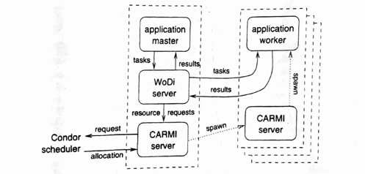

Slide 12
3.4 Communication Based Coscheduling 3.4.1 DemandBased Coscheduling
Dynamically schedules processes based on communication patterns.
Raises priority of processes receiving messages.
Challenges:
Preventing unfair artificial priority boosting.
Resolving scheduling conflicts between parallel jobs.
Solution:
Epoch numbers track spontaneous vs. message induced context switches.

Slide 13
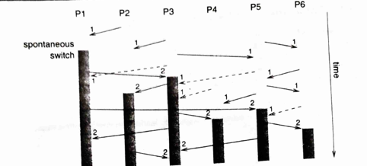

Slide 14
3.4.2 Implicit Coscheduling Implicit Coscheduling in UNIX
Uses system level priorities instead of explicit scheduling.
Communication based priority boosting.
Ensures smooth coscheduling without manual intervention.
Spin Blocking:
Reduces delays by combining short active waiting with blocking transitions.

Slide 15
3.5 Batch Scheduling 3.5.1 Admission Controls
HPC jobs demand high resources, impacting interactive users.
Batch Scheduling Systems:
DQS (Distributed Queueing System)
PBS (Portable Batch System)
Jobs are queued and scheduled based on runtime and memory needs.
Workstation Selection:
Prefer lightly loaded workstations over completely idle ones.

Slide 16
3.5.2 Case Study: Utopia/LSF Utopia Load Sharing Framework
Manages load across heterogeneous clusters.
Key Components:
Load collection mechanisms.
Process placement decisions.
Transparent remote execution.
LSF (Load Sharing Facility) is the commercial implementation.

Slide 17
